Slide 1
Brief Thoughts on Known Item Transactions
Kevin Reiss
Princeton University Libraries
kr2@princeton.edu
@kevinreiss

Slide 2
What is a Known Item Transaction?
Everything that happens post-discovery
Lookup Searches rather than discovery searches
Title Searches
Standard Number Searches
Citation Searches
Bibliographies
Page view of an item

Slide 3
Key Questions
Think about how many clicks does it take for a user to get from a known item screen to any of those services?
More clicks = more frustration, perception of a complicated system
Let’s look at some examples from our two most common “known-item” display avenues
Search results page
The “item” screen

Slide 4
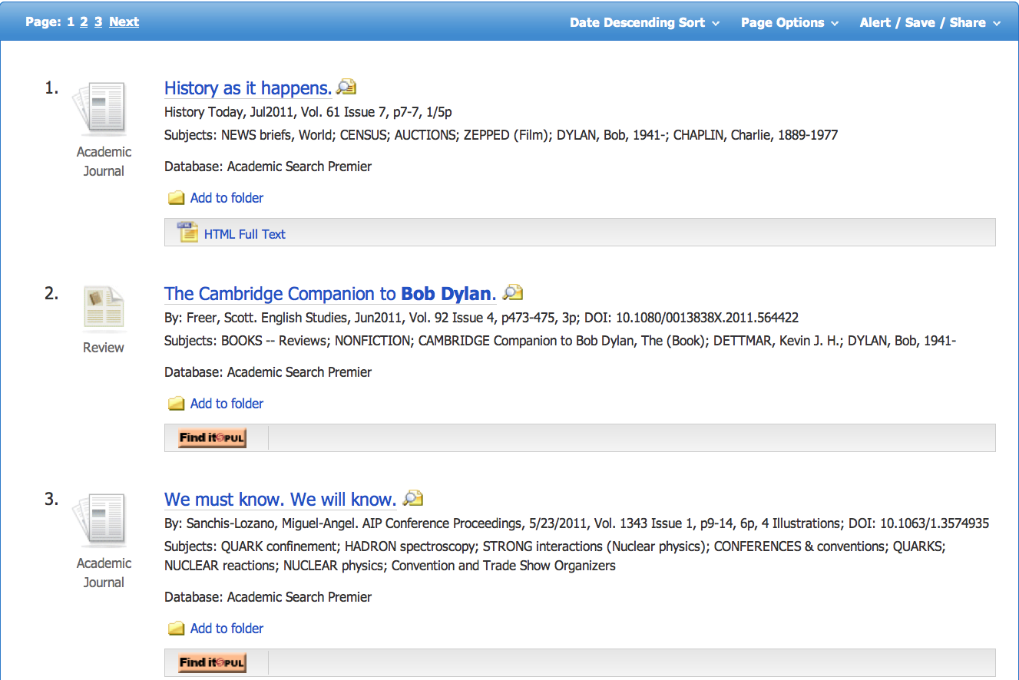
Ebscohost Search Results
Holy Grail = Full-Text
Link to OpenURL Service
Wouldn’t it be nice if these folders were easily connected to citation managers that are actually used

Slide 5
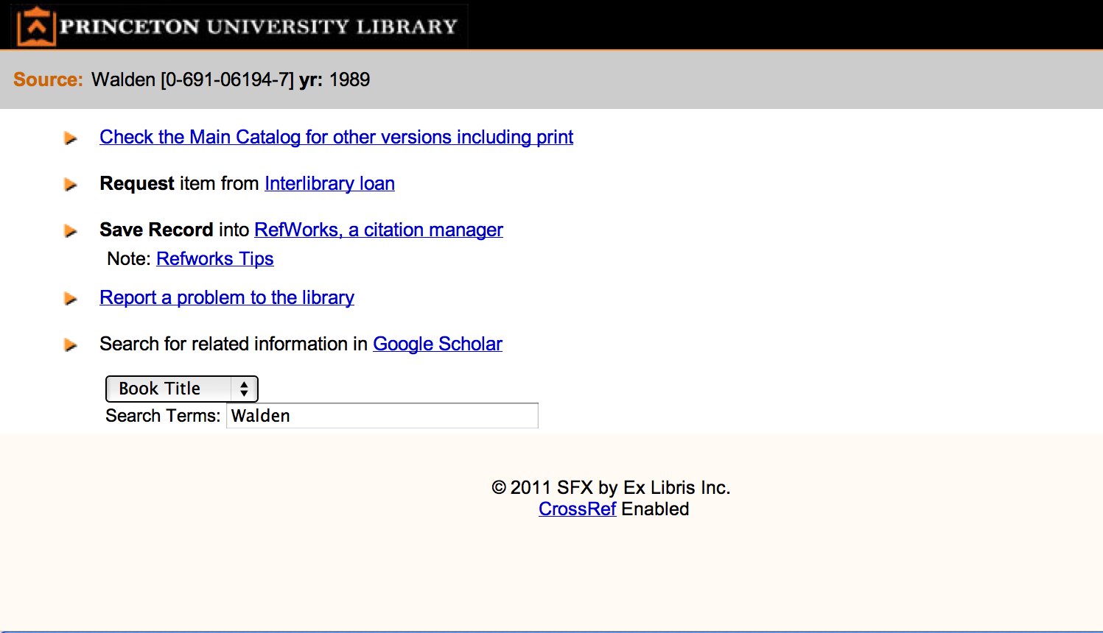
OpenURL Menu (Item Screen in Diguise)

Slide 6
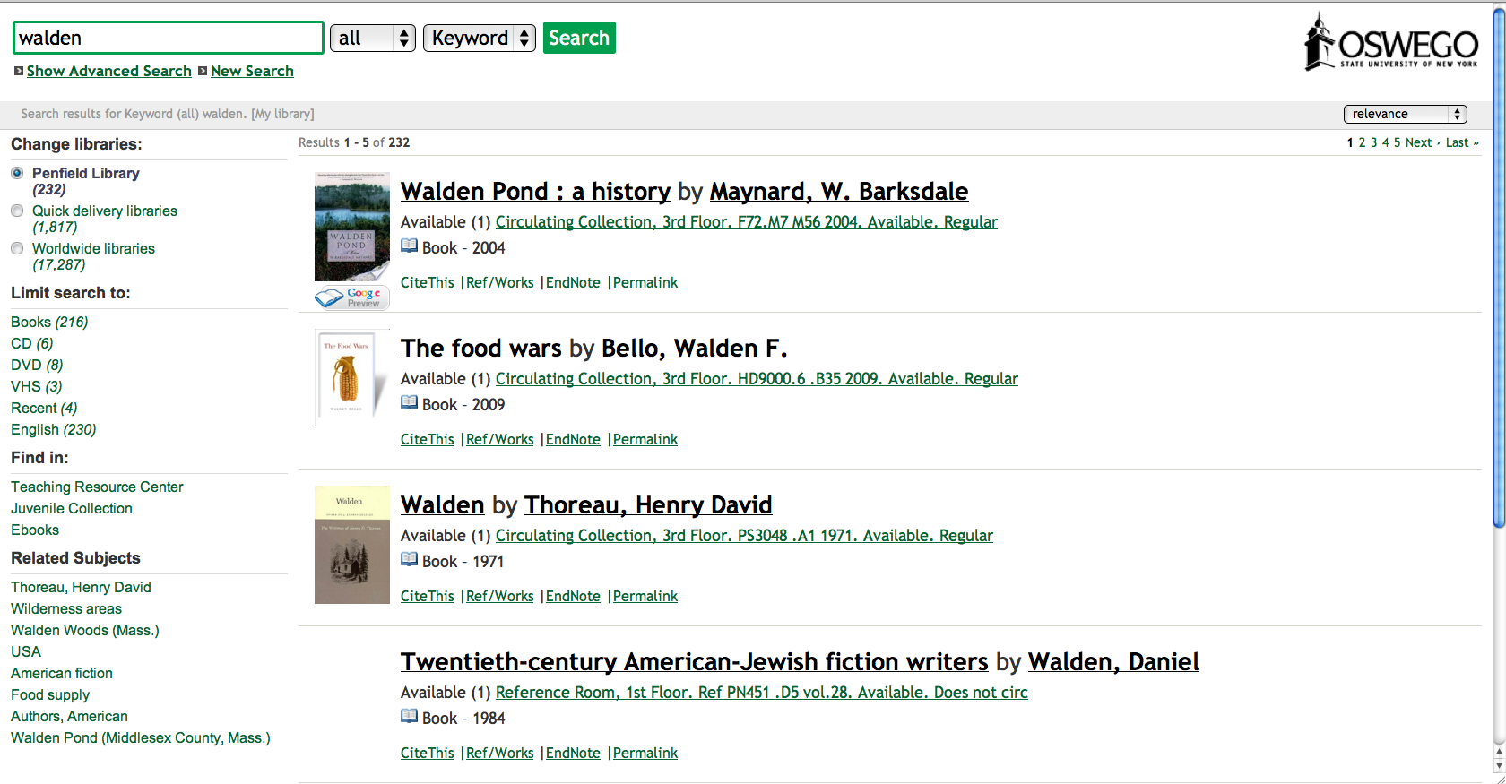
IDS Search Search Results Page
Let’s get it – go to ILLiad request form, but if we have full-text acccess?
Notes:
Link out to illiad can miss full-text leaving staff users to moderate the request

Slide 7
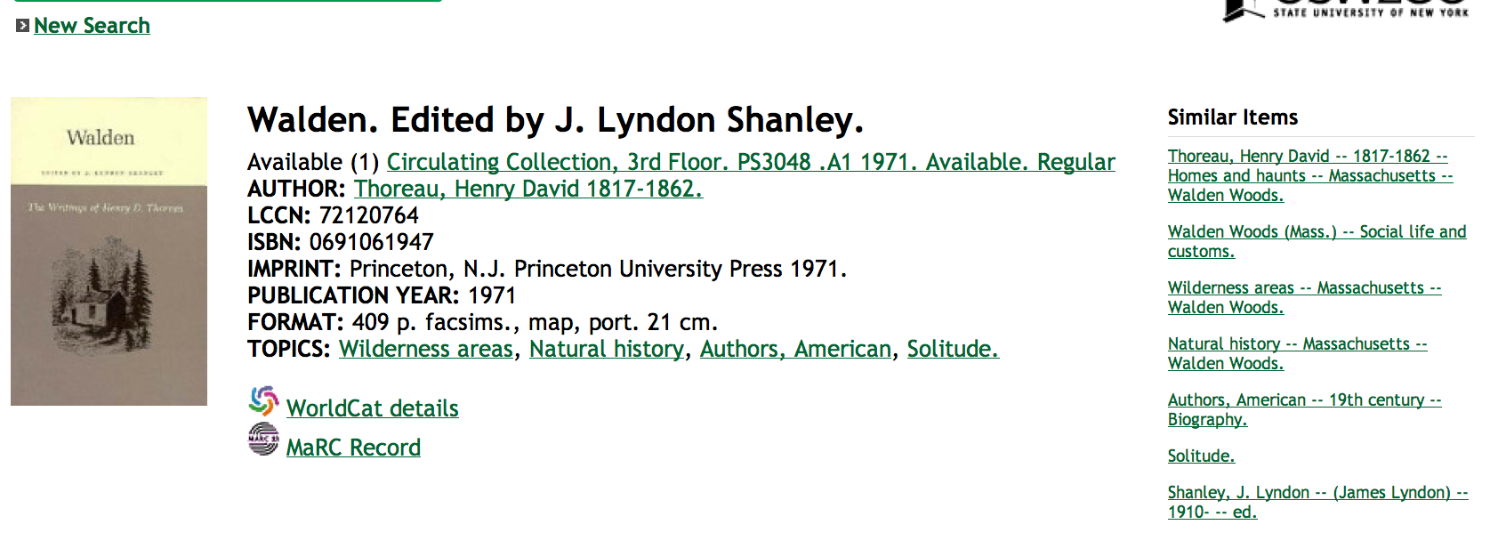
IDS Search Item Screen

Slide 8
Where to place your known item services?
On the individual item screen
On the search results page
Sometimes it is an uneasy mix
How can you reduce clicks/choices for the user
And still handle the complexity of your environment

Slide 9
Where do your users go?
How many clicks does it take them to get to your services?
We may be missing the point entirely?
Two very brief case studies:
U of Michigan
IDS Search

Slide 10
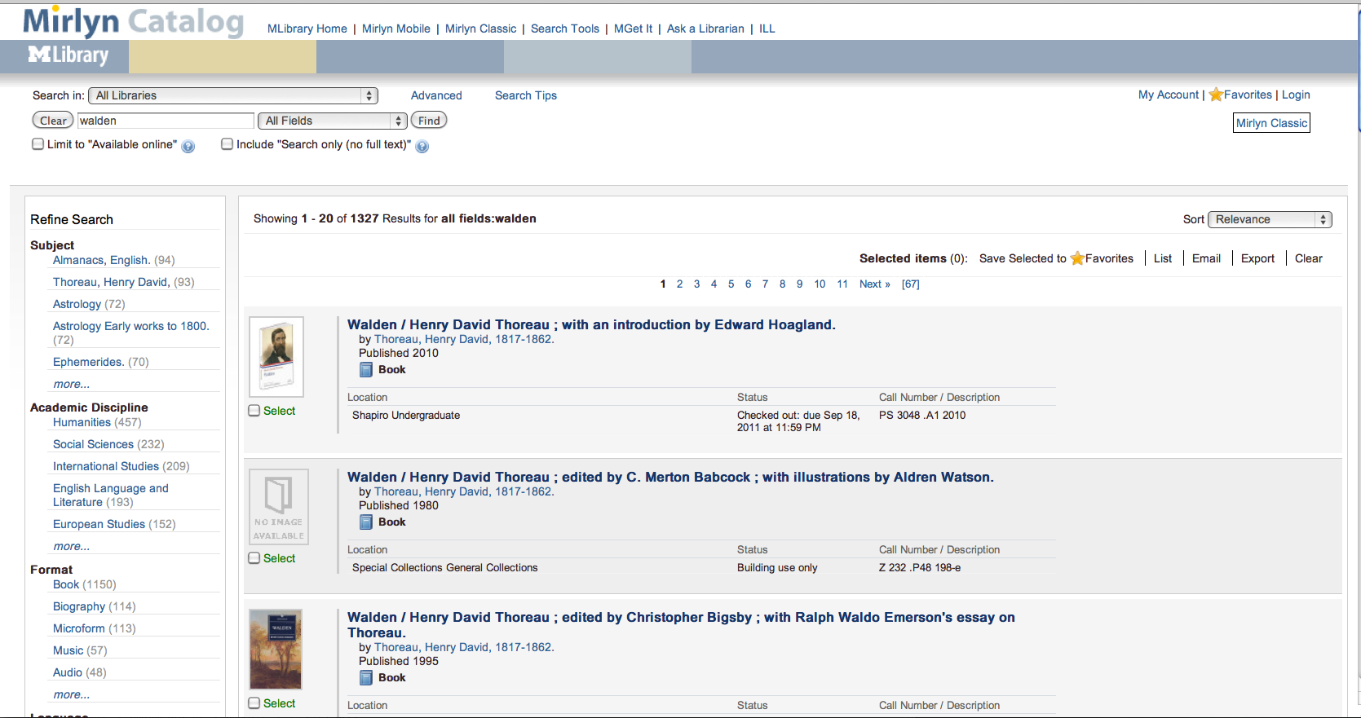
Mirlyn Catalog – Vufind System

Slide 11
Mirlyn Usage
Very few users ever advance past search screen
75% of all session consist of a single page load of the first page of search results
A low percentage of users make it to the item screen
78% of all “item” page views come from the first five search results (they default to twenty initial records)
54% of item views come from the first search result.
Read the full analysis
http://robotlibrarian.billdueber.com/how-good-is-our-relevancy-ranking/
http://robotlibrarian.billdueber.com/corrected-code4lib-slides-are-up/
http://www.lib.umich.edu/files/services/usability/MirlynSearchSurvey_Feb2011.pdf

Slide 12
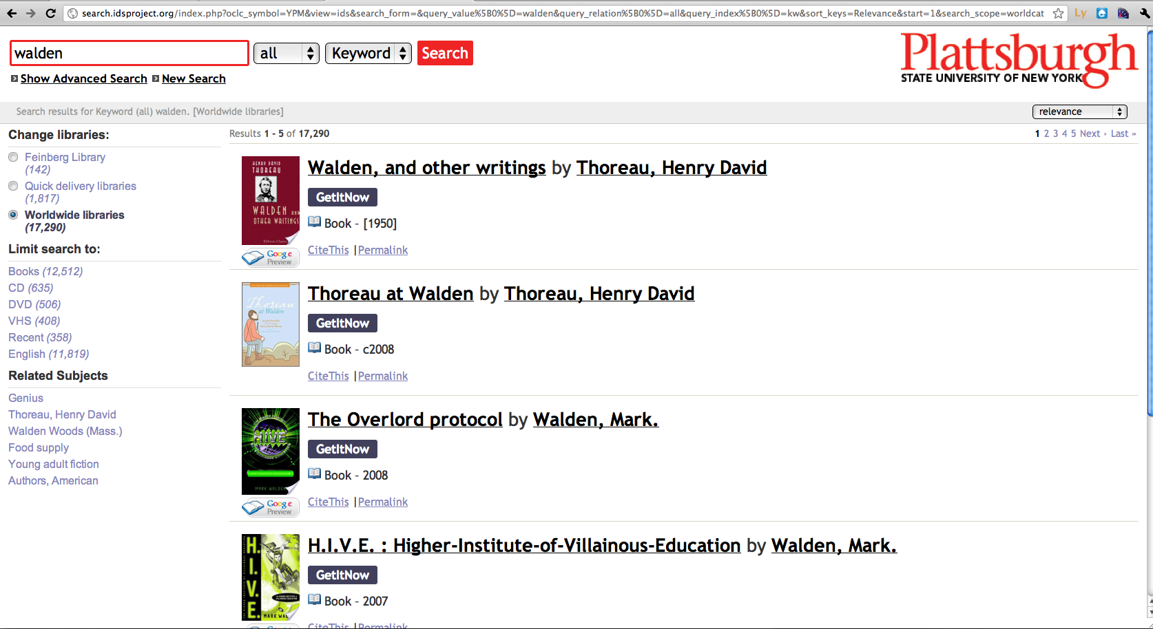
IDS Search

Slide 13
Another Case Study
IDS Search
Approx. 66,000 out of 567,000 year to date searches for title, isbn, or oclc number
793,191 out of 850,215 page views were of search results page, over 93%.
IDS Search defaults to initially display five result items

Slide 14
What does this Suggest?
We shouldn’t be placing an emphasis on anything that happens on the “item” screen
We probably want to focus on the “results” screen.
One problem:
You’ve got a lot concurrent requests to process

Slide 15
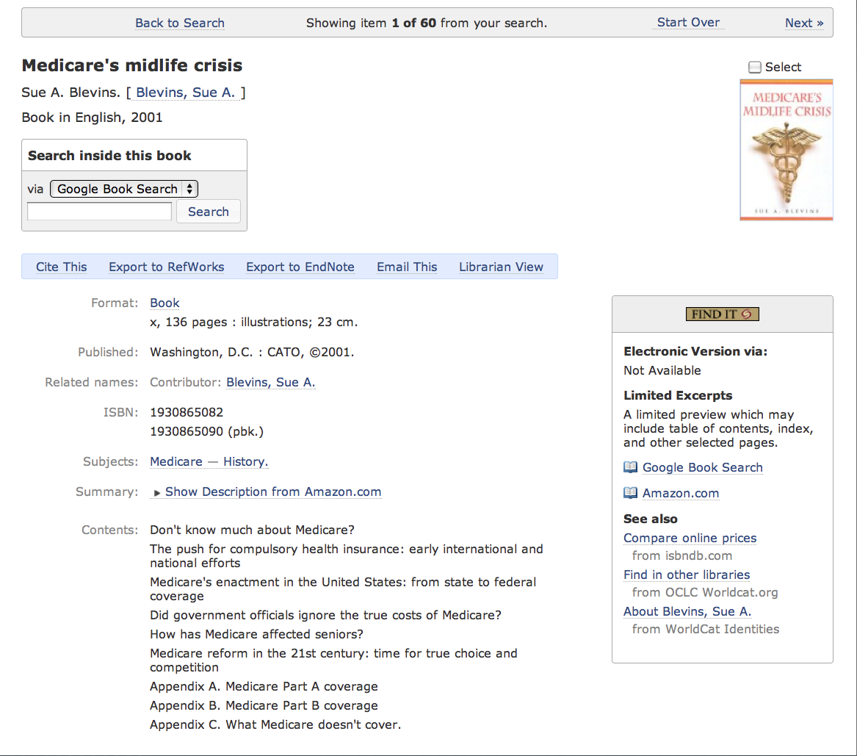
How many services are embedded on this page?

Slide 16
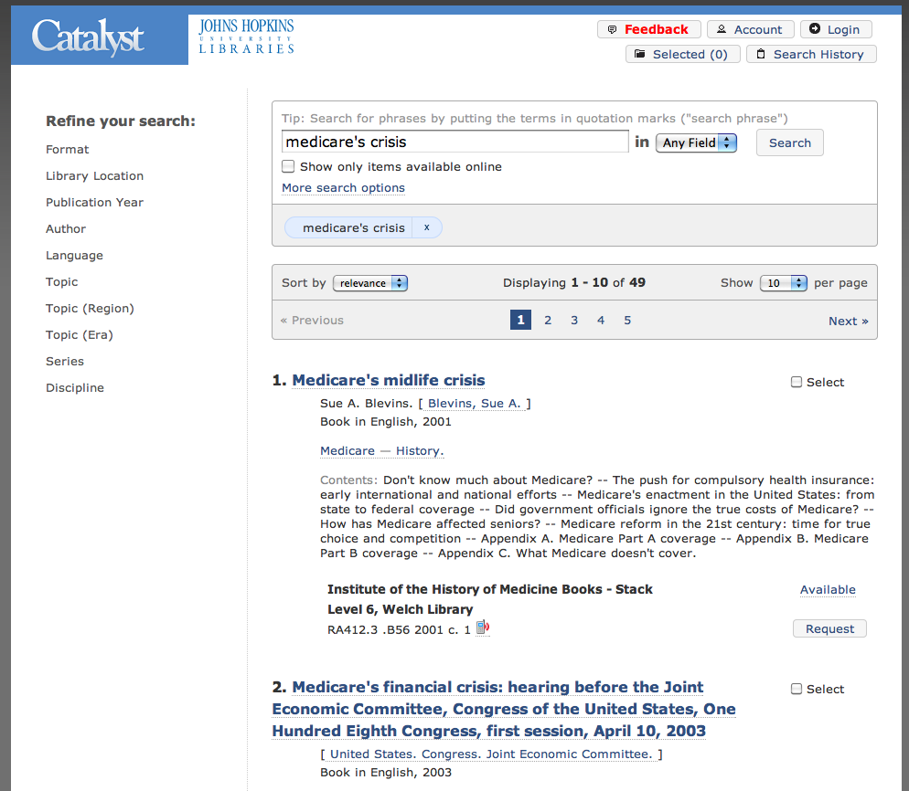
Ten Times
How many of those concurrent requests can we manage on this page?

Slide 17
Embedded Library Services
Think about a strategy for making your services more embeddable
How can you best represent the full gamut of your services in discovery systems
How can you get your content and services in the big content/search providers

